Slide 1

27TH JUNE 2023
CUSTOMER
CHURN PREDICTION PROJECT
(THE AZUBIAN CHALLENGE)

Slide 2
Meet Team
Tikue Zelete Eshete
Data Analyitcs Professional (Team Lead)
SERENE
Queensly Kyerewaa Acheampongmaa
Data Analytics Professional (Member)
Edwin Muiga Mwangi
Data Analyics Professional (Member)
A Team of Data Analytics Professionals who derive insights from Data to help Businesses
Maryanne Munchai
Data Analytics Professional (Member)
Florentia Teye
Data Analytics Professional (Member)
Team Serene

Slide 3

About the Project
This Project is for an African telecommunications company that provides customers with airtime and mobile data bundles and the goal is to develop a machine learning model to predict the likelihood of each customer churning.
The Team used Cross industry data analysis (CRISP-DM)framework for this project
The importance of this project is to enable the African telecommunications company to proactively retain customers, enhance customer experience, gain a competitive edge, and ensure long-term business sustainability. It is important for companies to make data-driven decisions, improve customer retention strategies, and foster stronger relationships with their customer base.
TEAM SERENE

Slide 4

Agenda
Team Serene
1 | Data Overview
2 | Exploratory Data Analysis
3 | Data Preprocessing (Feature Engineering)
4 | Model Selection
5 | Model Development and Evaluation
6 | Model Performance
7 | Development of User-friendly Interface (Gradio)
8 | Deployment of App
9 | App Interaction
10 | Thanks and Acknowledgements

Slide 5

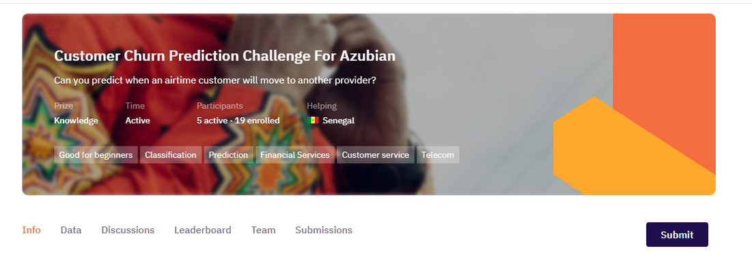
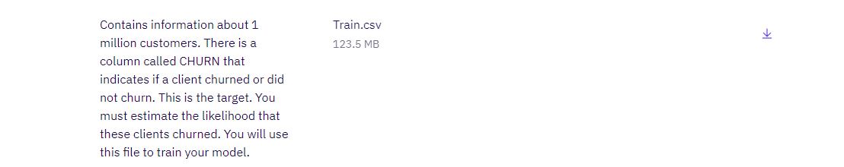
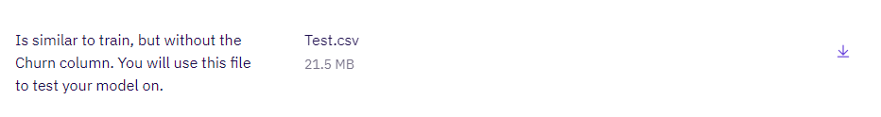
Data Collection and Overview
The data was collected as csv files on Zindi and it comprised of the Train and Test Data and also made available was the column variable description.
Back to Agenda

Slide 6
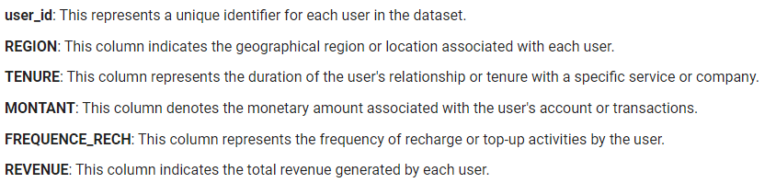
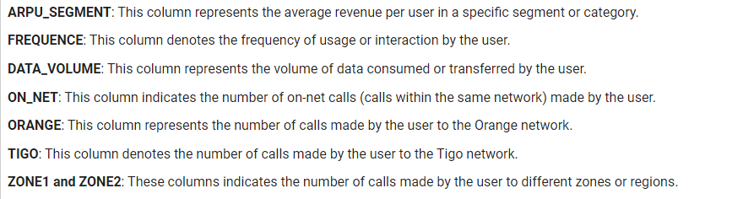
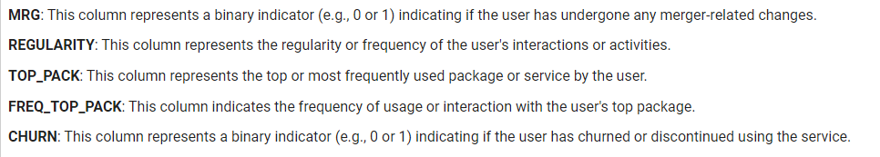
DATA
UNDERSTANDING
The provided dataset contains information related to telecommunications customers, including their region, tenure, recharge amount, frequency of recharge, revenue, data usage, and other variables as shown

Slide 7
Hypothesis
Null Hypothesis (H0)
There is no significant relationship between the customers' characteristics and the churn rate. In other words, the variables in the dataset have no impact on customer churn.
Alternate Hypothesis(H1)
There is a significant relationship between the customers' characteristics and the churn rate. The variables in the dataset have an impact on customer churn.
.
Team Serene

Slide 8
EDA & Data Preprocessing
Data cleaning, various analysis (Univariate, Bivariate and Multivariate) and Feature Engineering
To provide a solution to this problem being faced my the Telecommunications Company, we must conduct an Exploratory Data Analysis. This is to help us understand the data, select relevant features, engineer new features, preprocess the data, validate modeling assumptions, gain insights, and effectively communicate findings. The EDA is to help us to develop accurate and actionable churn prediction models that can drive success in this company.
Team Serene

Slide 9
Business Questions
What is the overall churn rate of the company?
Which region has the highest representation?
Which tenure has the highest representation?
Does the length of tenure (months) affect the churn rate of customers?
Which Region has most clients churning?
Do client churn or not churn if active for 90 days (Regularity)?
What's the correlation between the various features?
.
Team Serene

Slide 10
Insights Gathered
From the EDA performed we realized that the data is imbalanced since the number of customers who aren't churning made up the majority of the dataset. In dealing with this issue:
The evaluation metrics to be used is the Area Under Curve (AUC)
The type of machine learning algorithms that will be used are the Tree based models and other regression models.
It can be concluded from the hypothesis testing that there is a significant relationship between all the customer's charaterictics and the Churn which is the target feature except the MRG (a client who is going) column.
Team Serene

Slide 11
Feature Processing and Engineering
Feature engineering involves transforming the dataset into a format suitable for training a machine learning model. This includes handling missing values, scaling numerical features, and encoding categorical variables. Additionally, there may be the need to create new features or extract relevant information from existing ones to improve the model’s predictive power.
(Zone1 and Zone2 have missing values with percentages of 92.1 and 93.6 respectively. Since it's above 90%, they will be dropped.
MRG (a client is going) column has just one value ('NO'). During the hypothesis testing, it was the only column that had no significant relationship with the Churn. It will be dropped too.)

Slide 12
Model Selection & Development
In this Customer Churn Prediction Project, it is imperative to choose an appropriate machine learning algorithm. Since this Project is a classification Project, some common algorithms best for it include logistic regression, random forests, support vector machines, and gradient boosting algorithms. Different models need to be evaluated using suitable performance metrics (ROC_AUC) to determine which one performs best for this project.
Five (5) of these Algorithms were trained, evaluated and compared;
Logistic Regression
Random Forest Classifier
Gradient Boosting Classifier
K Nearest Neighbors
Decision Tree Classifier
Team Serene

Slide 13
HYPERPARAMETER TUNING
Hyperparameter tuning is important in machine learning models because they help to control their behavior and performance. Tuning these hyperparameters can significantly impact the model’s predictive power.
In performing hyperparameter tuning, the training data is divided into a set for training and a set for testing the hyperparameters, which is also known as the validation set.
Team Serene

Slide 14
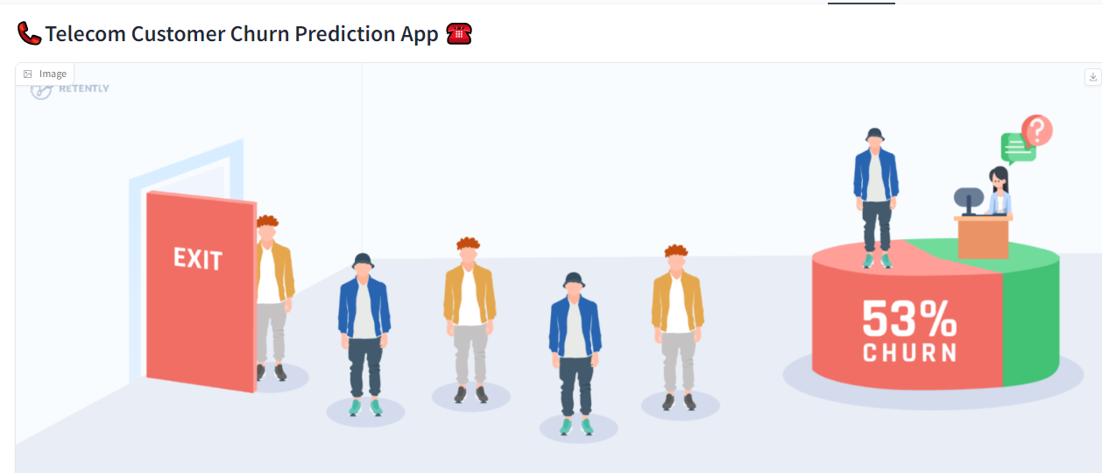

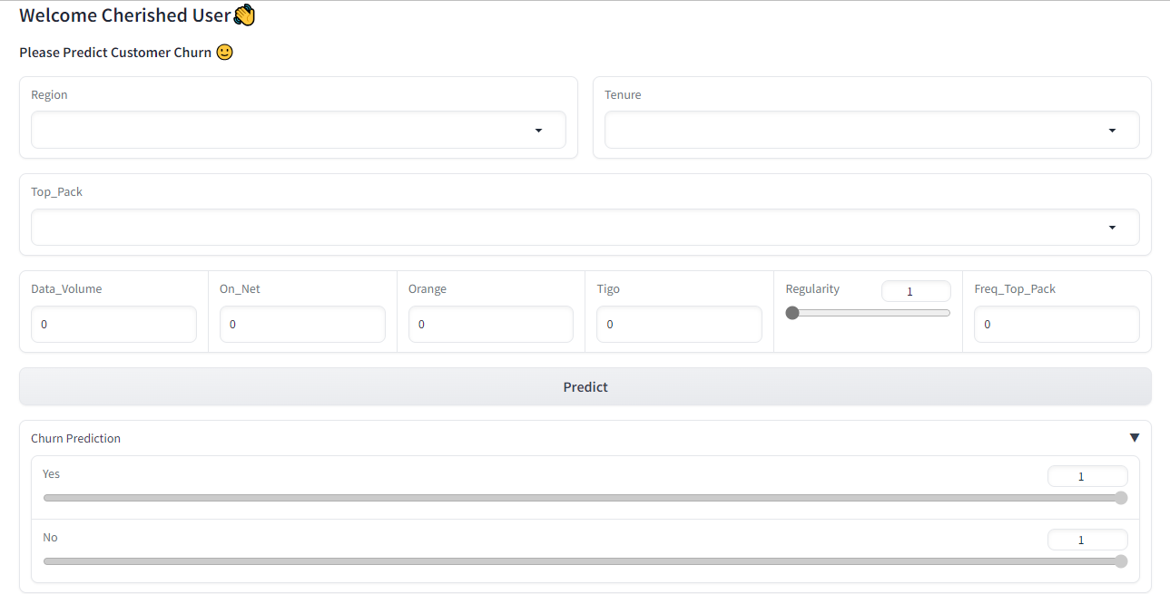

Slide 15

Connect with Team
on our various LinkedIn Pages
Tikue Zelete Eshete
https://www.linkedin.com/in/tikue-zeleke/
Queensly Kyerewaa Acheampongmaa
linkedin.com/in/queensly-kyerewaa-acheampongmaa/
Edwin Muiga Mwangi
https://www.linkedin.com/in/edwin-mwangi/
Maryanne Munchai
https://www.linkedin.com/in/maryanne-muchai/
Florentia Teye
https://www.linkedin.com/in/florentia-teye/

Slide 16


SPECIAL THANKS
A heartfelt gratitude to the entire team for the successful completion of this Course. Our special thanks to the Data Science for the great mentorship, guidance, and supervision provided by Teach Ops, highlighting their profound knowledge, insightful feedback, dedication to teaching and lasting impact we have had on our academic journey.

Slide 17
THANK YOU

